Slide 1
Study of different multiplexing techniques and comparison among them: FDM, CDM & TDM
Group members:
1. Md. Sabbir Hossen; Id: 1706074
2. Ahadur Rahman; Id: 1706075
3. Khandaker Khairuzzaman; Id: 1706076
4. Kazi Ishrak Ahmed; Id: 1706077

Slide 2
fdm
A multiplexing technique in which multiple separate information signals can be transmitted over a single communication channel by occupying different frequency slots within common channel bandwidth

Slide 3
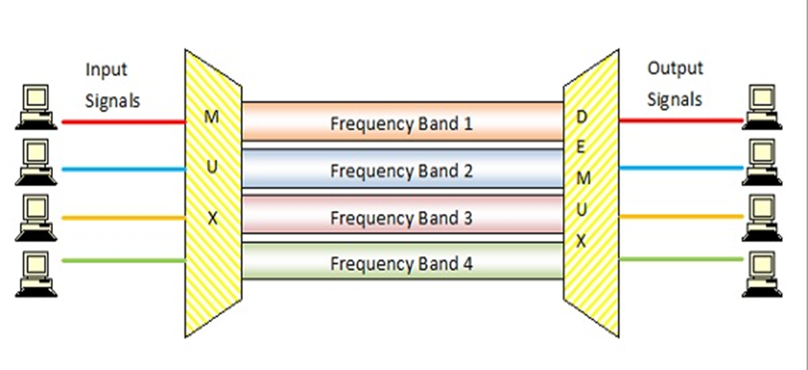
example

Slide 4
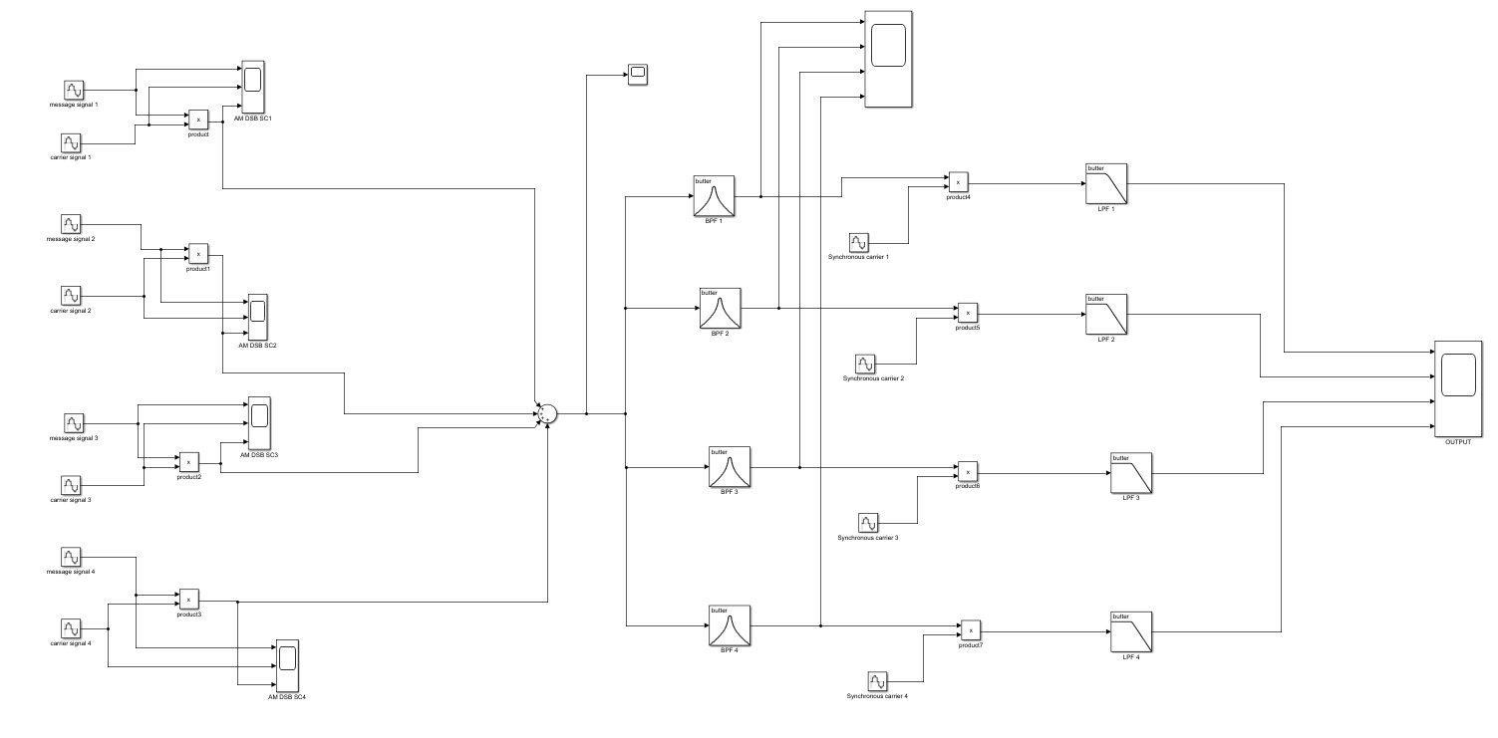
Simulink Model diagram

Slide 5
Message signal and carrier
channel | Message signal | Carrier signal
Channel 1 | Sin(2*pi*5) | 2Cos(2*pi*50)
Channel 2 | Sin(2*pi*10) | 2Cos(2*pi*100)
Channel 3 | Sin(2*pi*15) | 2Cos(2*pi*150)
Channel 4 | Sin(2*pi*20) | 2Cos(2*pi*200)

Slide 6
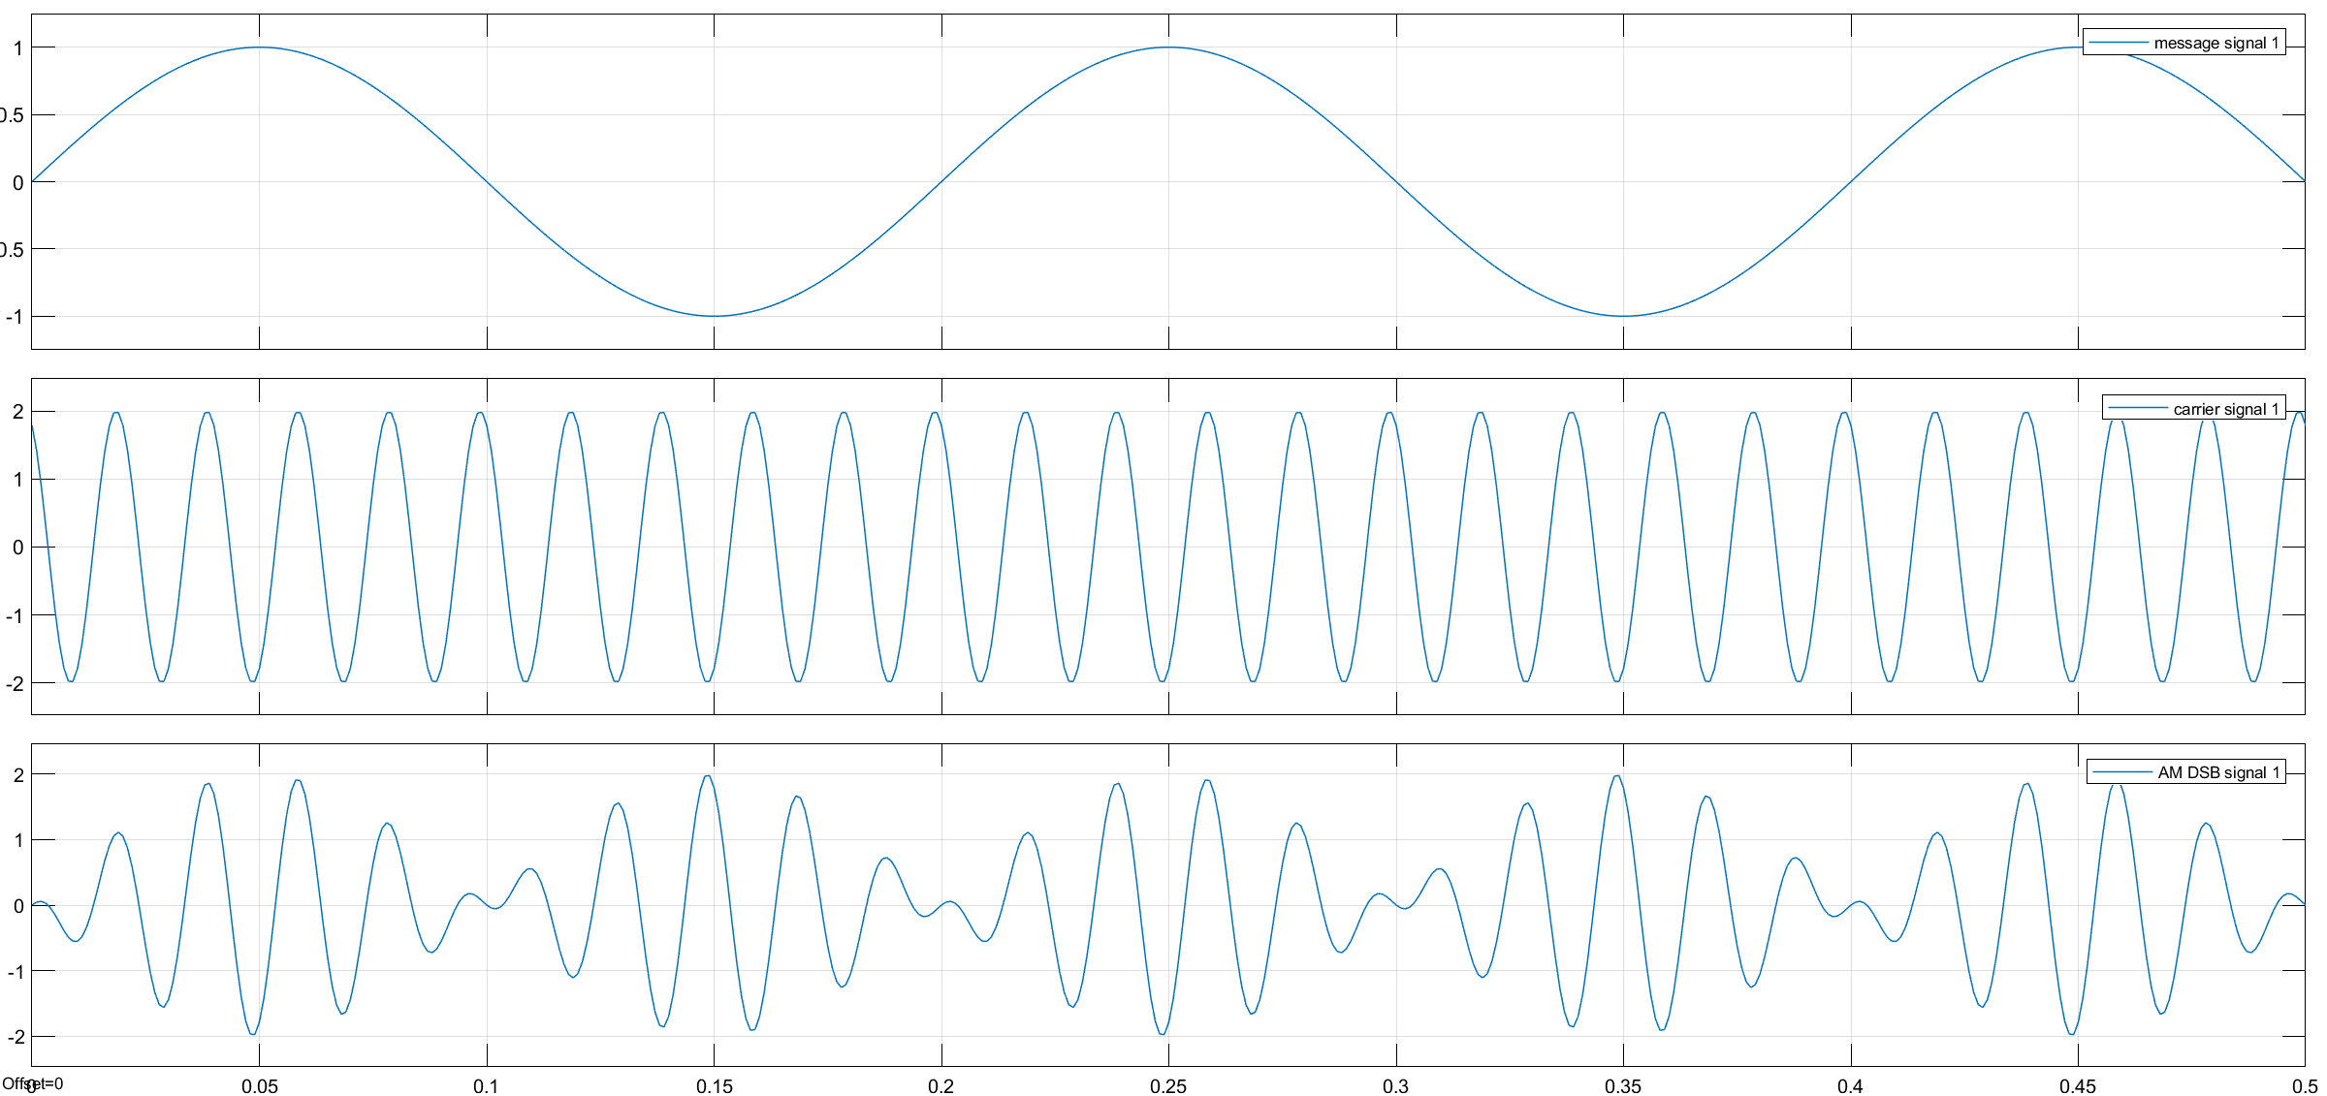
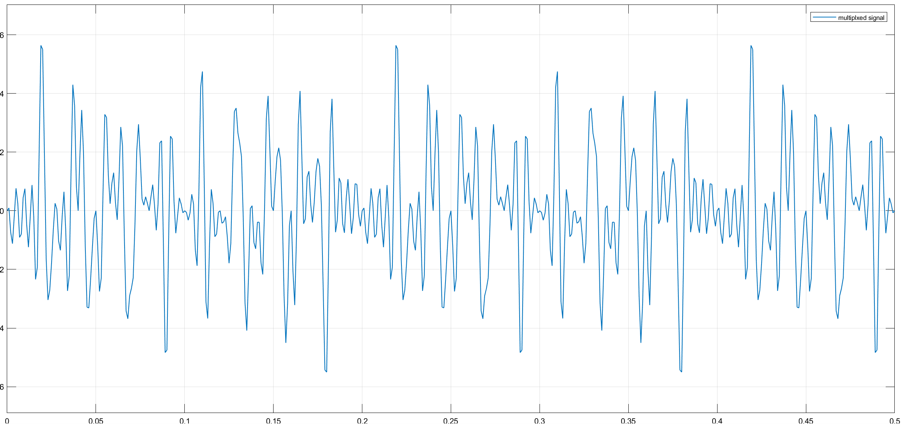
Output of am dsb scope

Slide 7
filter
Band pass filter:
Low pass filter:
Filter | Type | Order | Low cutoff frq | High cutoff freq
BPF 1 | Butterworth | 5 | 45 Hz | 55 Hz
BPF 2 | Butterworth | 8 | 90 Hz | 110 Hz
BPF 3 | Butterworth | 8 | 135 Hz | 165 Hz
BPF 4 | Butterworth | 8 | 180 Hz | 220 Hz
Filter | TYPE | Order | Cutoff freq
LPF 1 | Butterworth | 5 | 10
LPF 2 | Butterworth | 8 | 20
LPF 3 | Butterworth | 8 | 30
LPF 4 | Butterworth | 8 | 40

Slide 8
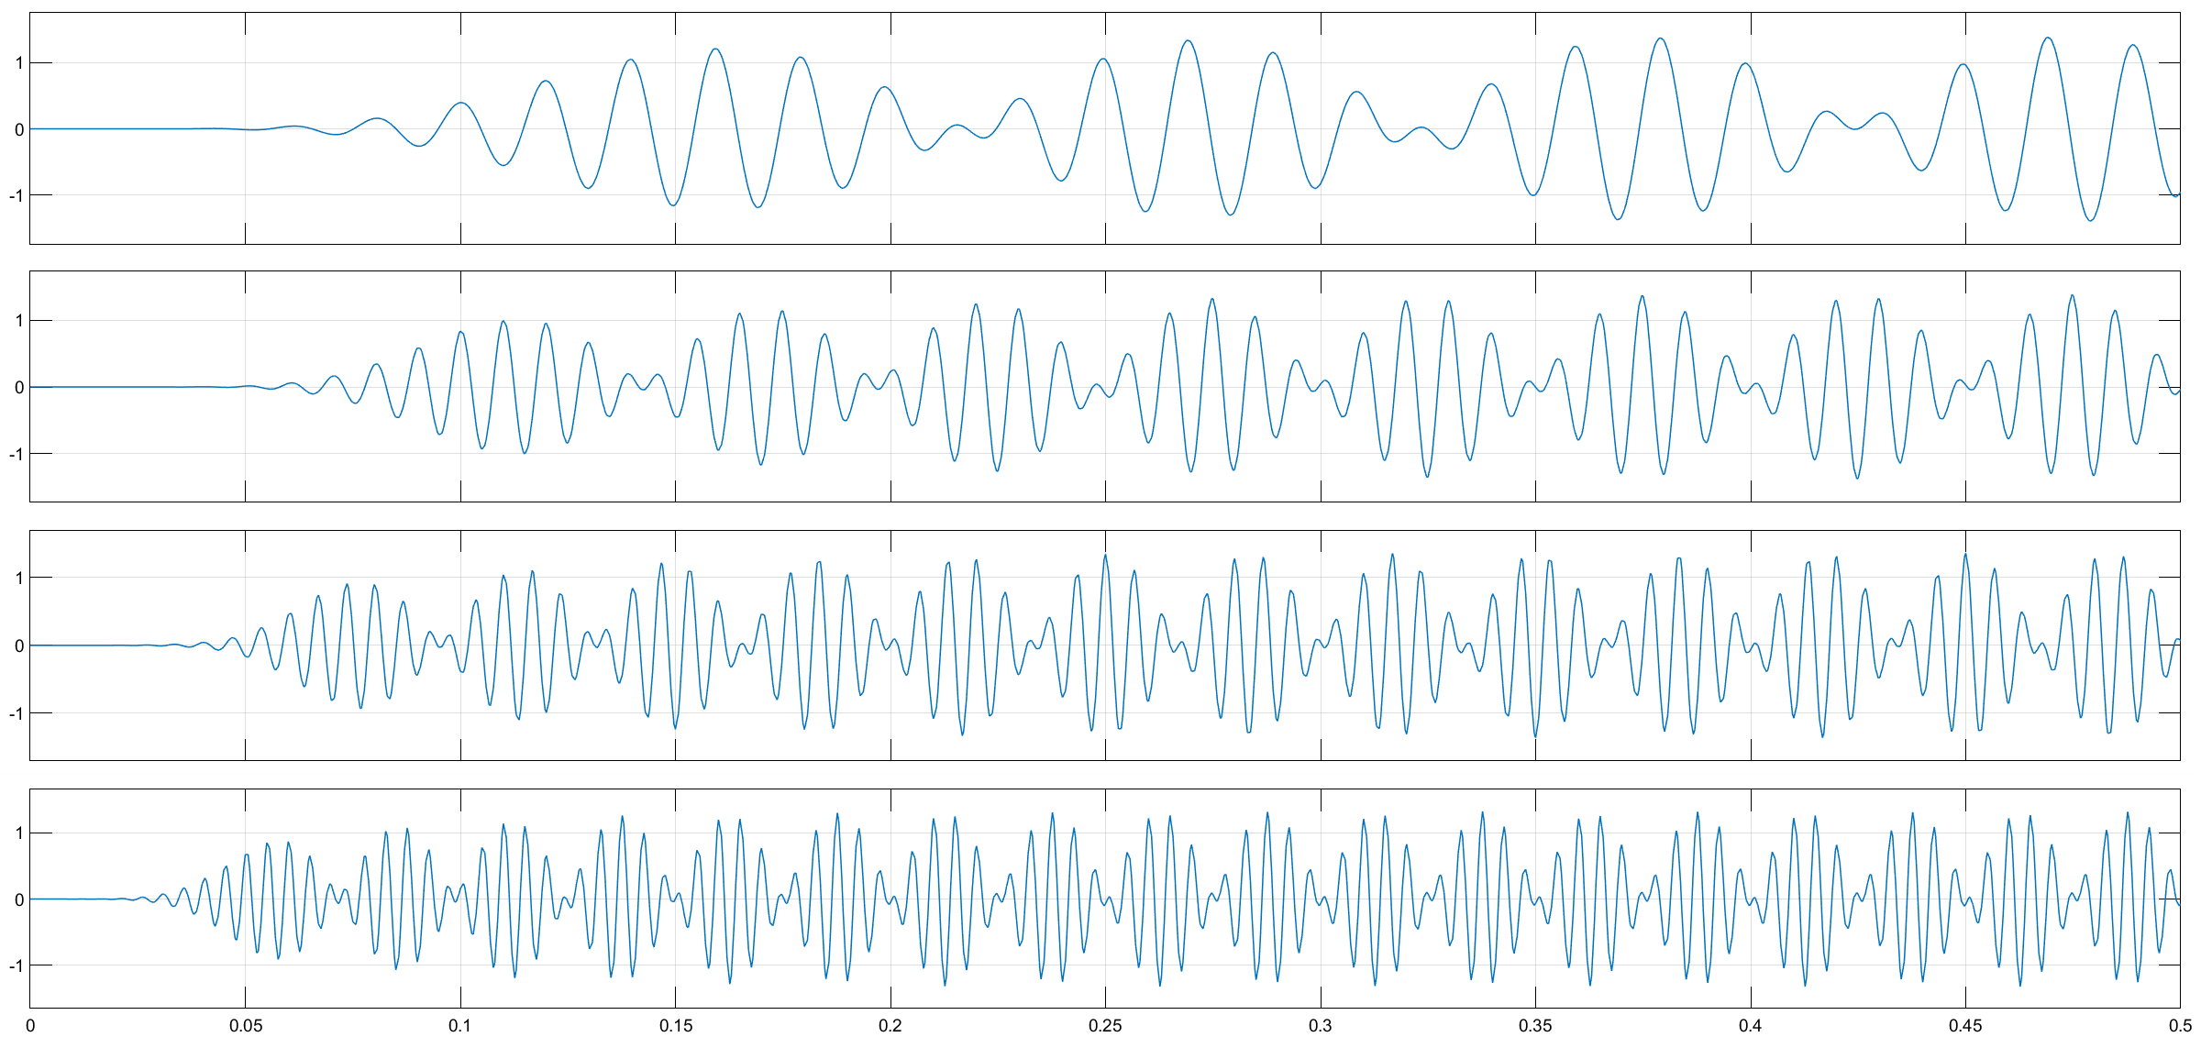
Demodulated output:

Slide 9
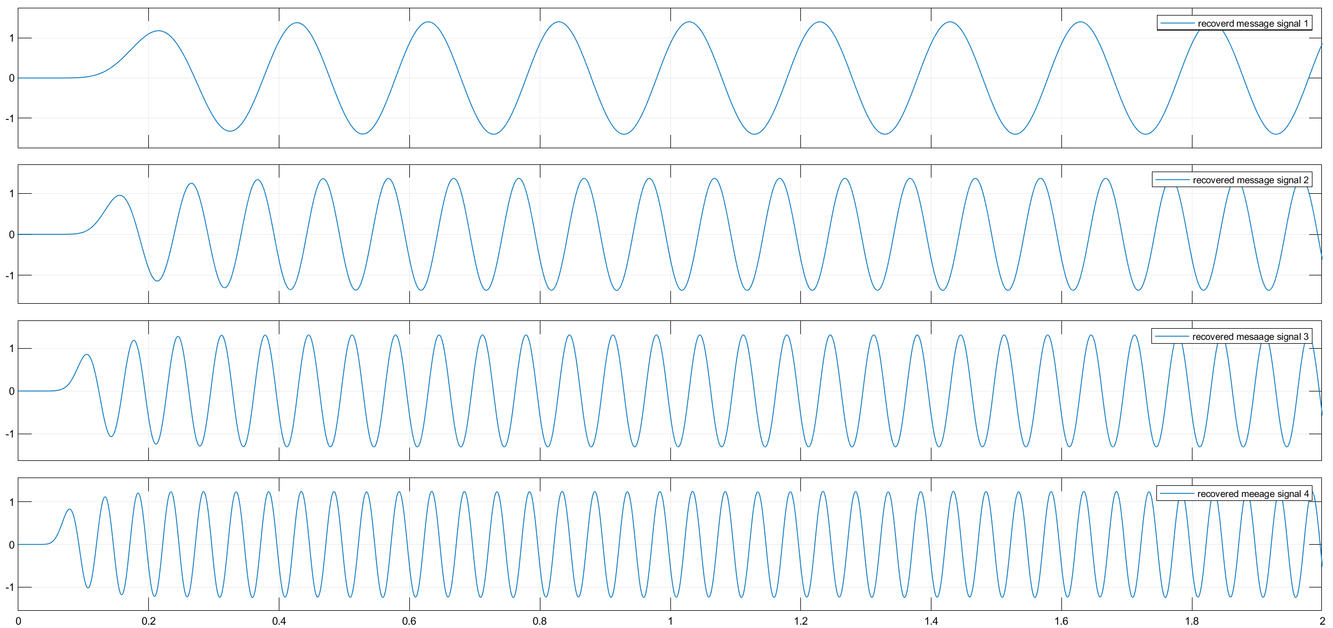
Recovered signal:

Slide 10
TDM
A multiplexing technique by which multiple data signals can be transmitted over a common communication channel in different time slots

Slide 11
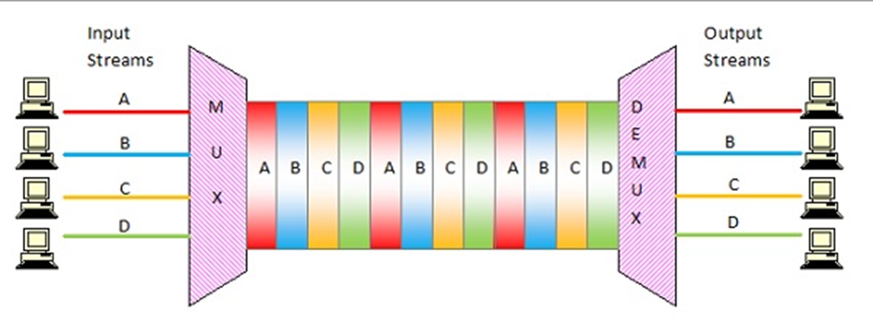
example

Slide 12
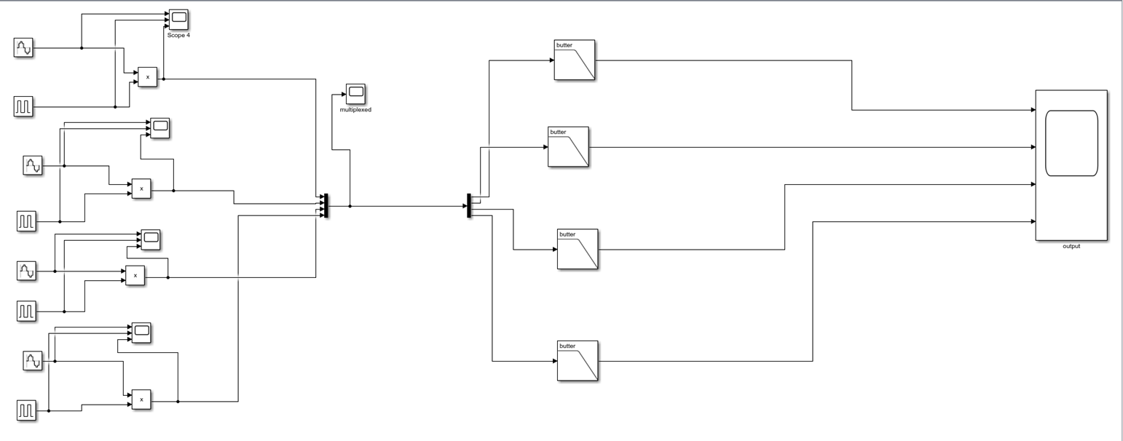
Simulation process and model diagram

Slide 13
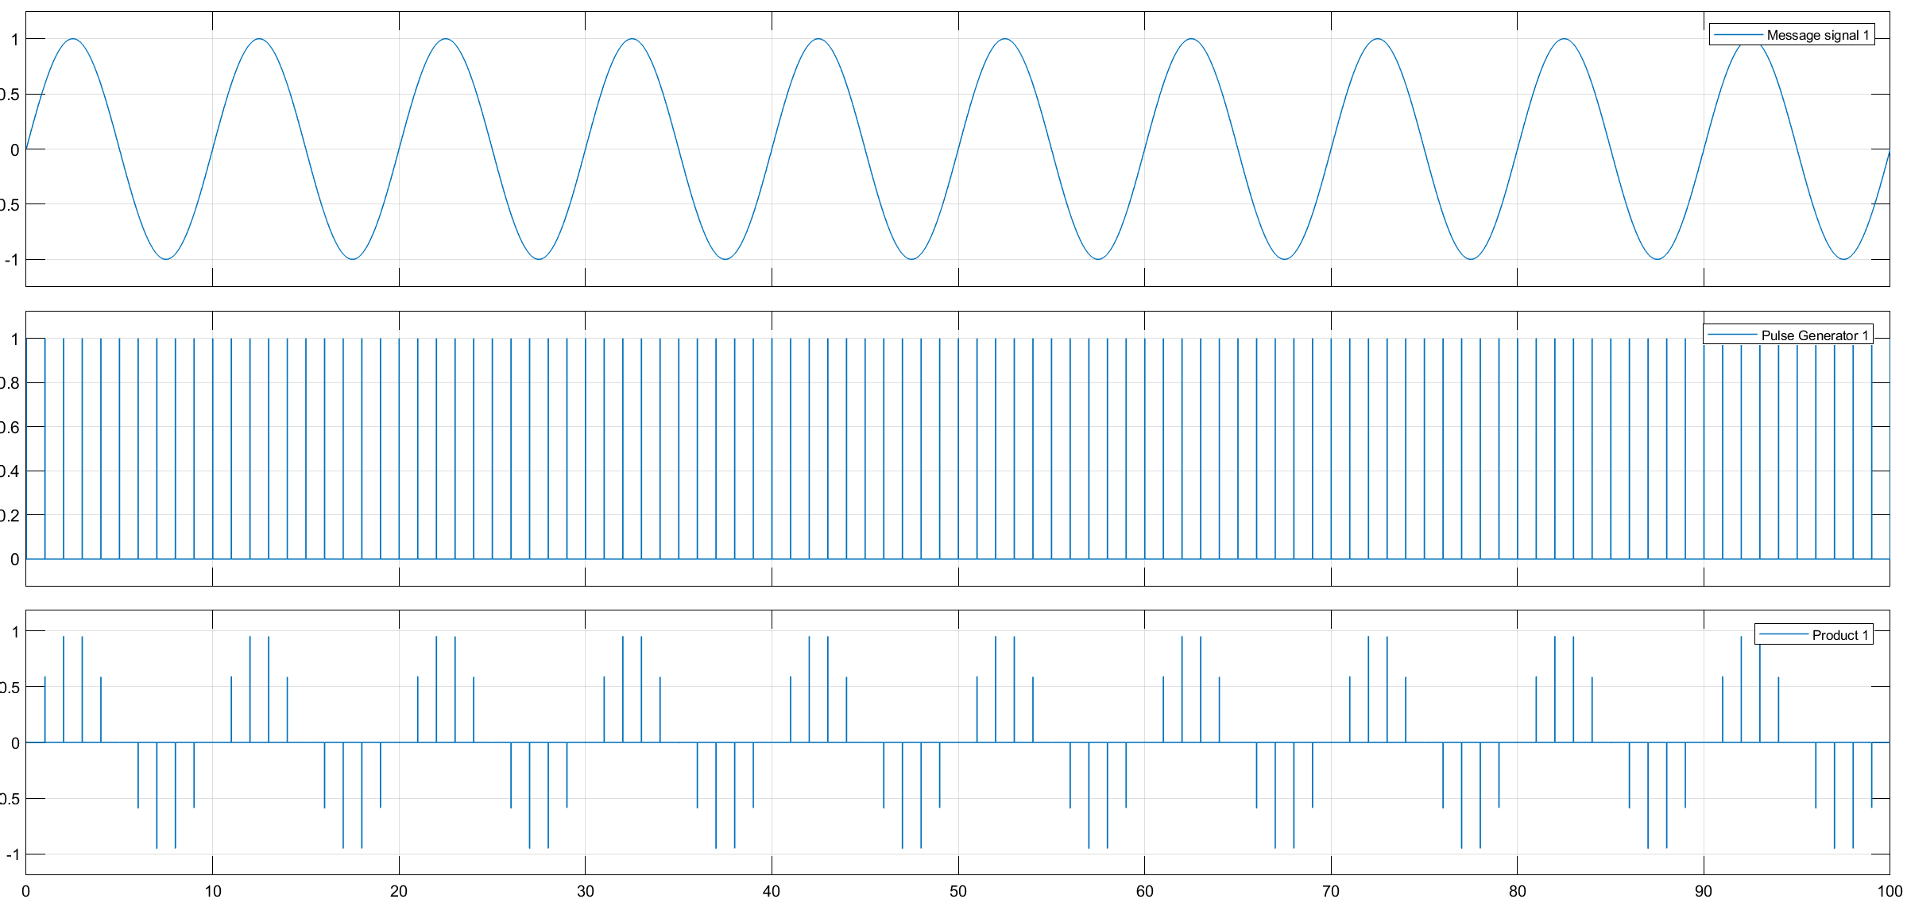
Message signal

Slide 14
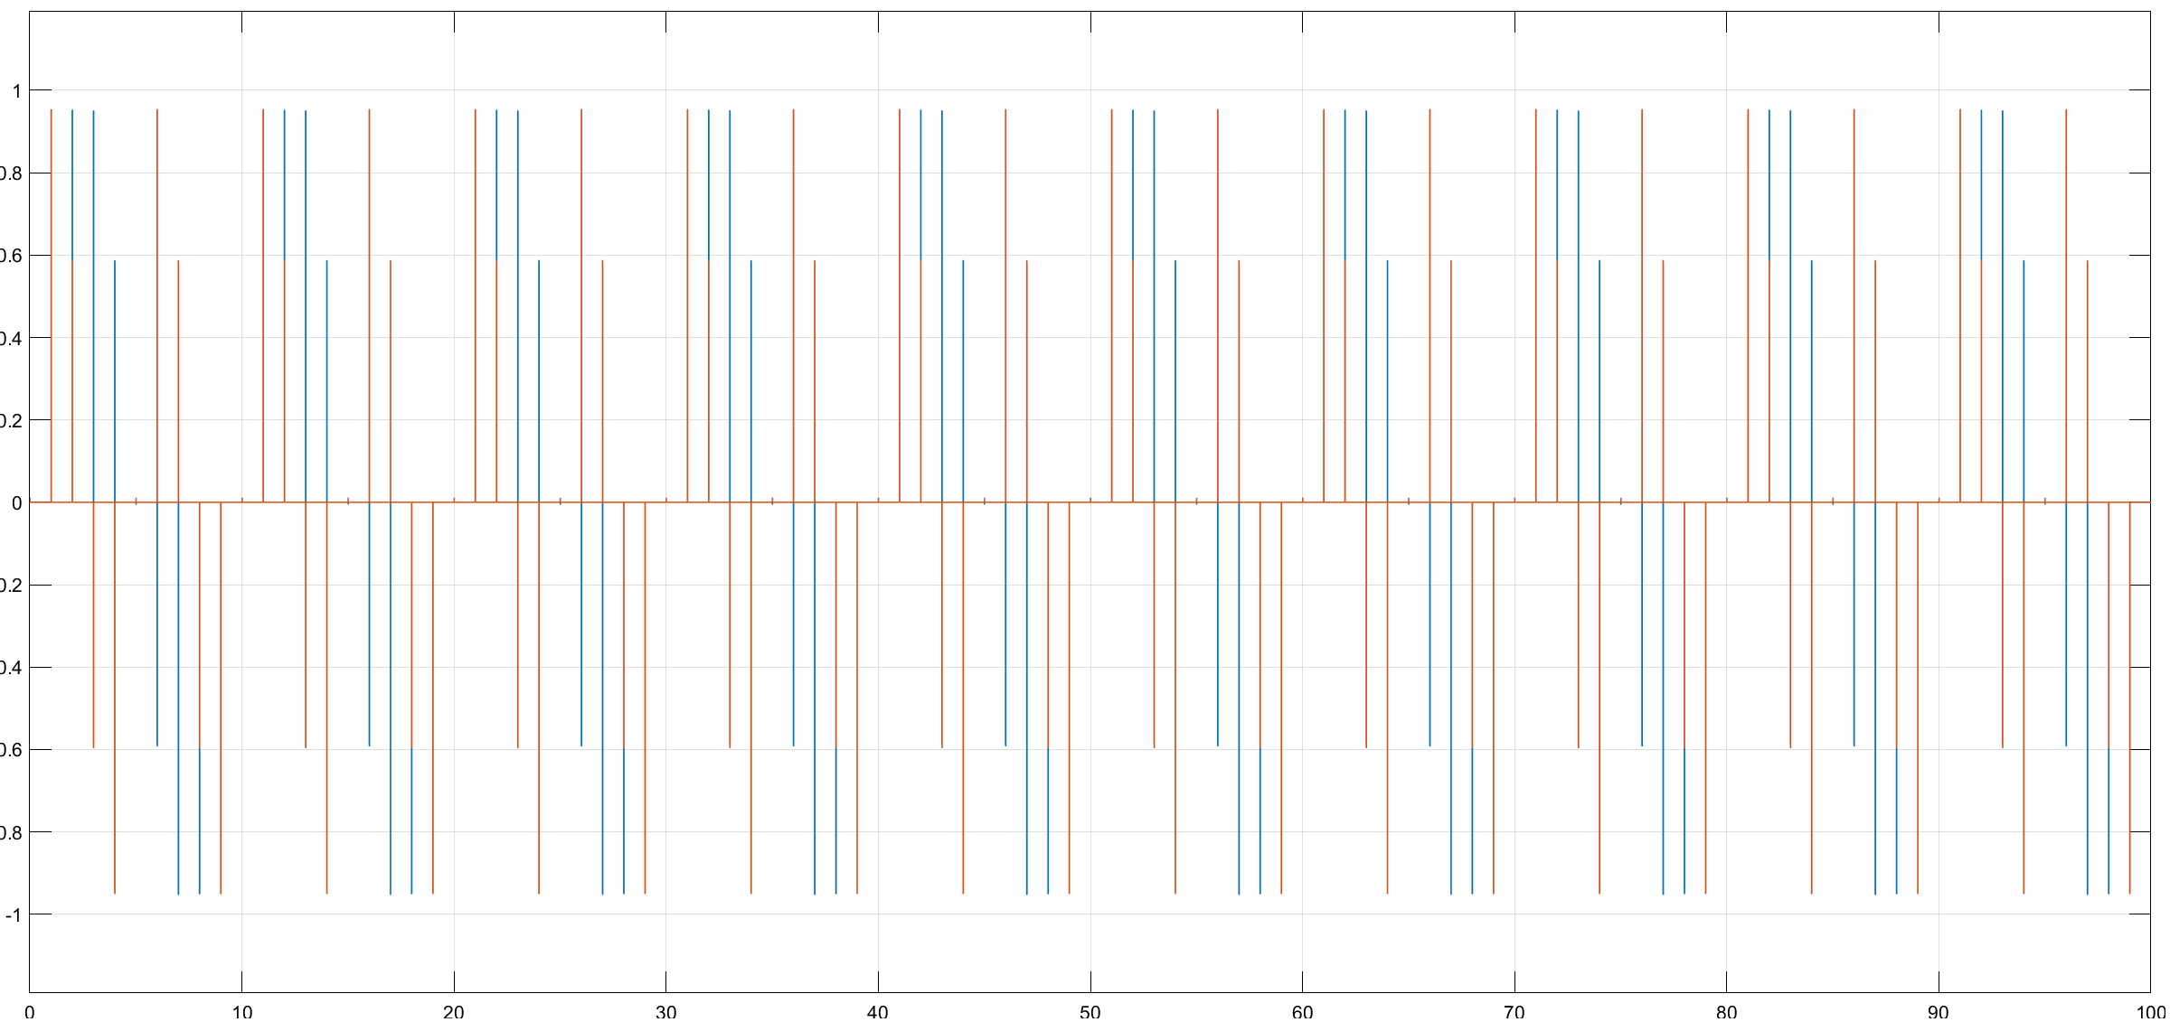
Multiplexed output

Slide 15
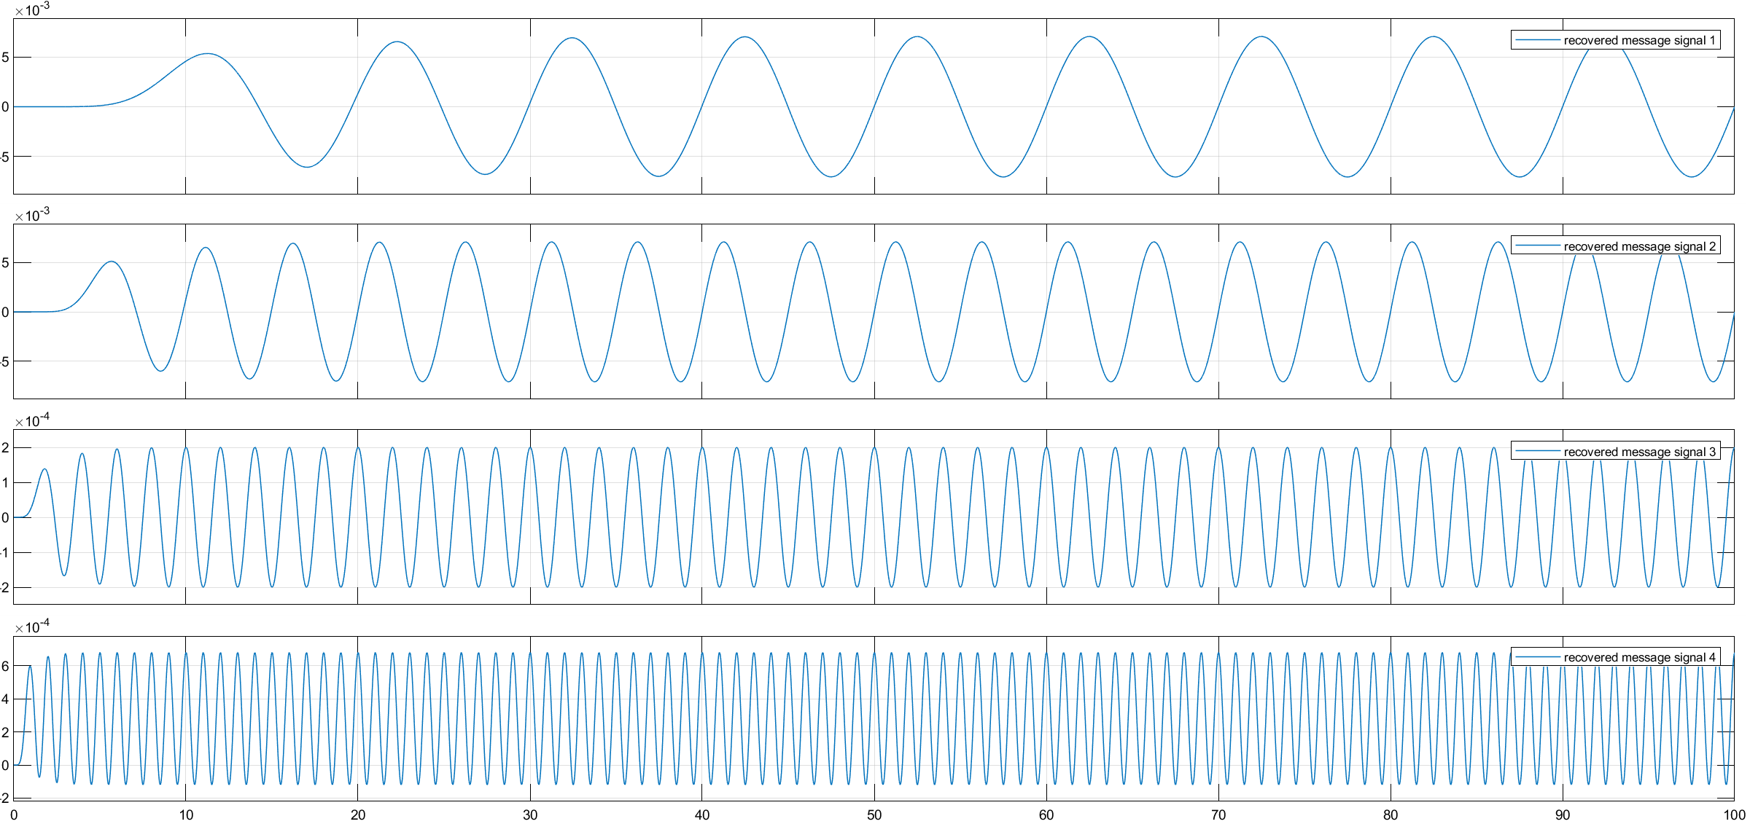
Recovered signals

Slide 16
CDM
A networking technique in which multiple data signals are combined for simultaneous transmission over a common frequency band

Slide 17
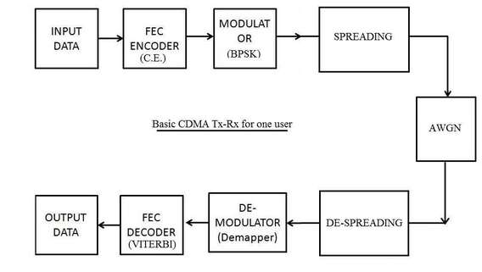
example

Slide 18
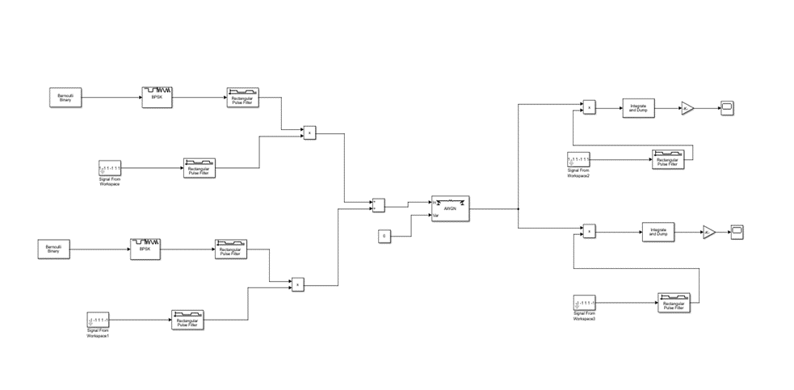
Simulation model diagram

Slide 19
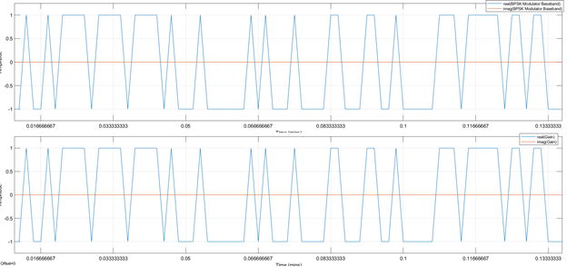
Transmitter & Receiver Output

Slide 20
comparison
FDM | TDM | CDM
In this, sharing of bandwidth among different stations takes place | In this, only the sharing of time of satellite transponder takes place | In this, there is sharing of both i.e. bandwidth and time among different stations takes place
There is no need of any codeword. | There is no need of any codeword. | Codeword is necessary
In this, there is only a need for guard bands between the adjacent channels | In this, a guard time of the adjacent slots is necessary | In this, both guard bands and guard time are necessary
Synchronization is not required | Synchronization is required | Synchronization is not required
The rate of data is low | The rate of data is medium | The rate of data is high
It is a little flexible | It is moderate flexible | It is highly flexible

Slide 21
Thank You

